Slide 1
E-Commerce Clothing Recommendation Prediction
Balaji Subramani
Karuna Baswal

Slide 2
Dataset
👦
https://www.kaggle.com/nicapotato/womens-ecommerce-clothing-reviews/
Anonymous Company but real source
1,205
0 - 122
Cloth
Positive Feedback Count
21
4
Class
1 - 5
Division
22,634
7
Rating
Departments
Reviews
Yes | No
Recommended

Slide 3

Goal !
Recommendation
Prediction

Slide 4
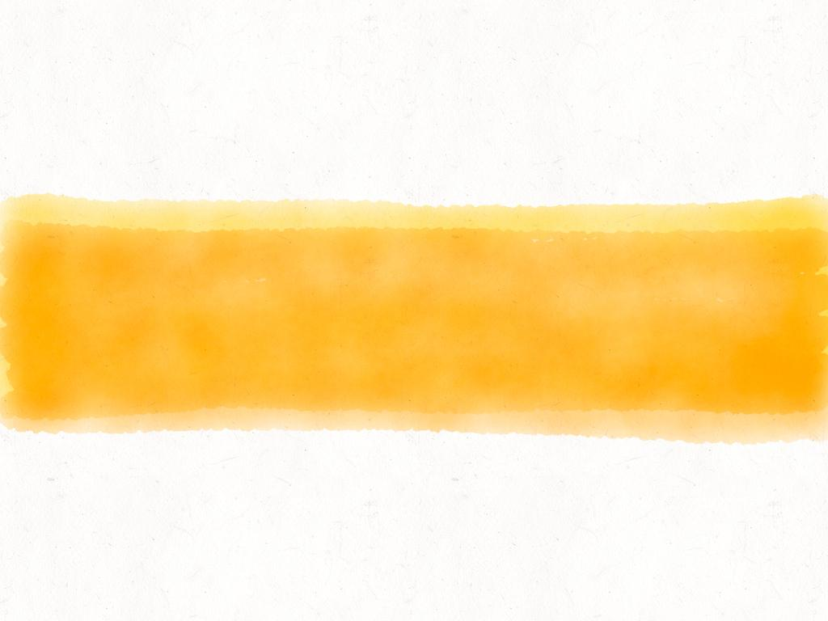
Project Flow
Data Analysis
Data Preprocess
Model Building
Model Validation
Buissness inference
Model Validation

Slide 5
Feature Engineering
Encoding categories
Text Preprocessing
Splitting Train/Test data
Normalizing numeric values
Lexicon Based Sentiment Classifier
TF-IDF
4
3
Preprocessing
Remove punctuation, Stemming, Stopwords Lemmatization ,
2
Tokenizing
Merging Topic & Review text and Splitting into Tokens
1

Slide 6
Machine Learning Models
Linear classification
SVM
Decision Tree
Random Forest

Slide 7

Accuracy
Cross Matrix
Precision
Recall
Validation
F Score
AUC
ROC

Slide 8
Business Inference
Influencing words for Recommendation
Influencing categories in Recommendation
Is there any correlation between Reviews and Recommendation

Slide 9

Planning
Feature Reduction
PCA
Model build
Backtrack from PCA to Original Data
Business Inference

Slide 10
Thank you

